Slide 1
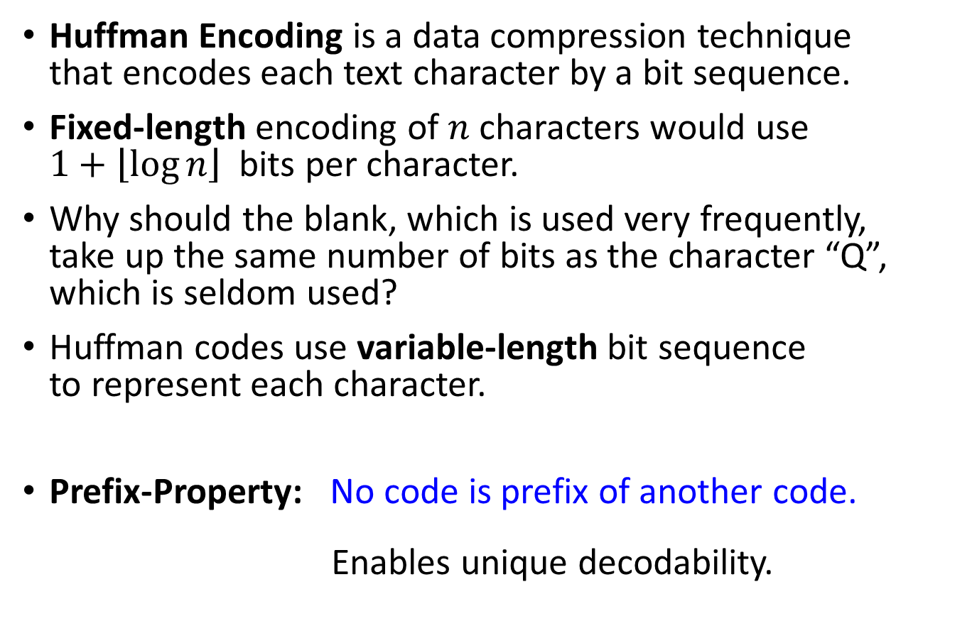
Huffman Encoding
Huffman Encoding is a data compression technique that encodes each text character by a bit sequence.
Fixed-length encoding of $n$ characters would use $1+\left\lfloor \log{n}\right\rfloor$ bits per character.
Why should the blank, which is used very frequently, take up the same number of bits as the character “Q”, which is seldom used?
Huffman codes use variable-length bit sequence to represent each character.
Prefix-Property: No code is prefix of another code. Enables unique decodability.

Slide 2
Huffman Encoding
If we use only a few bits to represent characters that appear often and reserve longer bit sequences for characters that don’t appear often, the overall size of the document being represented will be smaller.
The idea comes from Morse code.
Morse code uses variable-length code of dots and dashes (like 0s and 1s)

Slide 3
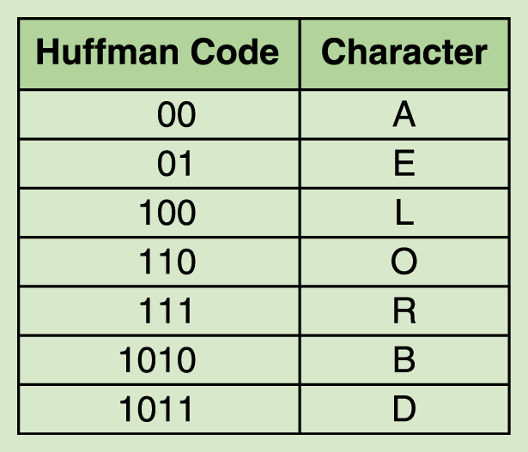
Huffman Encoding
An example of a Huffman alphabet

Slide 4
Huffman Encoding
DOORBELL
Coded as:
1011
110
110
111
1010
01
100
100

Slide 5
Huffman Decoding
Here is where you need the prefix-property
1 0 1 1 1 1 0 1 1 0 1 1 1 1 0 1 0 0 1 1 0 0 1 0 0

Slide 6
Huffman Encoding
DOORBELL would be encoded in binary as 1011110110111101001100100.
If we used a fixed-size bit string to represent each character (say, 8 bits), then the binary form of the original string would be 64 bits.
The Huffman encoding for that string is 25 bits long, giving a compression ratio of 25/64, or approximately 0.39.

Slide 7
Huffman’s Algorithm
Input: symbols and their frequency-counts
Output: binary-code for each symbol.
Property: optimum compression-rate with prefix-property.

Slide 8
Huffman’s Algorithm − Example run
frequency-count
17
11
4
13
6
a
b
c
d
e
symbol
Step 1: Construct a min-PQ of these symbols based on their frequency as key.
4
6
11
13
17
c
e
b
d
a

Slide 9
Step 2: Replace the 2 minimum frequency symbols by one “combined symbol” and place it in the PQ.
↓
↓
4
6
11
13
17
c
e
b
d
a

Slide 10
Step 2: Replace the 2 minimum frequency symbols by one “combined symbol” and place it in the PQ.
↓
4
6
11
13
17
c
e
b
d
a
↓
10
4
6
c
e

Slide 11
Repeat Step 2 until only one remains in the PQ.
↓
↓
13
17
d
a
21
10
11
b
4
6
c
e

Slide 12
Repeat Step 2 until only one remains in the PQ.
↓
↓
21
30
10
11
13
17
b
d
a
4
6
c
e

Slide 13
Repeat Step 2 until only one remains in the PQ.
51
21
30
10
11
13
17
b
d
a
4
6
c
e

Slide 14
Step 3: A binary tree results.
51
21
30
10
11
13
17
4
b
d
a
6
c
e

Slide 15
Step 3: A binary tree results.
root-to-leaf
path
51
21
30
10
11
13
17
4
b
d
a
6
c
e

Slide 16
Step 3: A binary tree results. Label left-branches 0, right-branches 1
51
0
1
21
30
0
1
0
1
10
11
13
17
0
1
4
b
d
a
6
c
e

Slide 17
Step 4: The code for each symbol is the binary sequence along the corresponding root-to-leaf path.
51
0
1
21
30
0
1
0
1
10
11
13
17
0
1
4
b
d
a
6
01
10
11
c
e
000
001

Slide 18
Prefix-Property
Optimum Compression-Ratio
51
0
1
21
30
0
1
0
1
10
11
13
17
0
1
4
b
d
a
6
01
10
11
c
e
000
001
Compressed bit length = ∑ ( char-code-length × frequency-count)
= 3 × 4 + 3 × 6 + 2 × 11 + 2 × 13 + 2 × 17
= 112

Slide 19
